Slide 1
Mechanical Mass-Energy Storage Systems: Making Clean, Renewable Energy Work
Ryan Policheri and Aaron Smith

Slide 2
Motivation and the Issue at Large
Burning fossil fuels to generate electricity is the biggest source of greenhouse gas emissions
Clean, renewable energy sources try to solve this problem, but they are fundamentally incompatible with our electrical energy system
Energy storage systems can be implemented to make these clean, renewable energy sources compatible with the electrical energy system
We think there is a compelling argument for mechanical storage systems as opposed to chemical storage systems

Slide 3
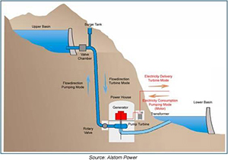
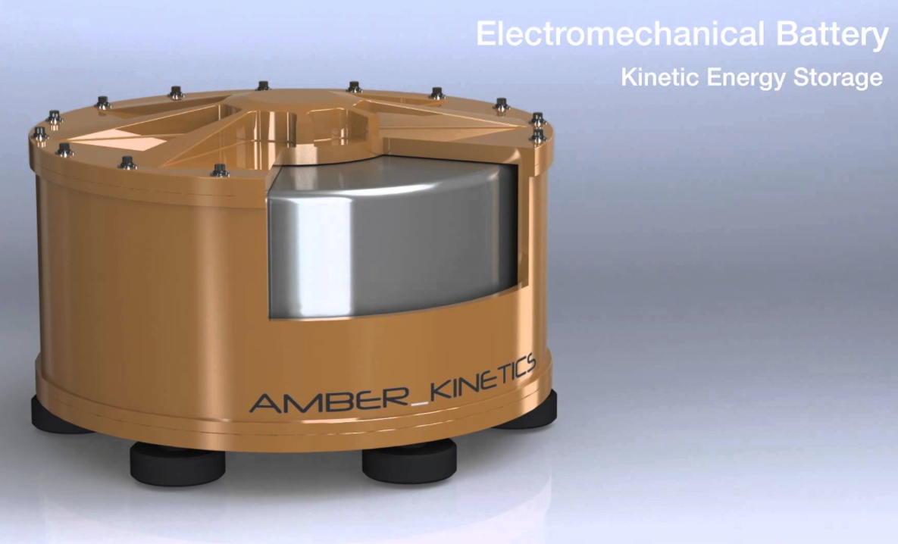
What is Mechanical Storage?
Storing energy using mechanisms to harness gravitational energy, kinetic energy, elastic energy, pressure energy, etc.
Some examples include pumped-storage, flywheel storage, and pressurized storage

Slide 4
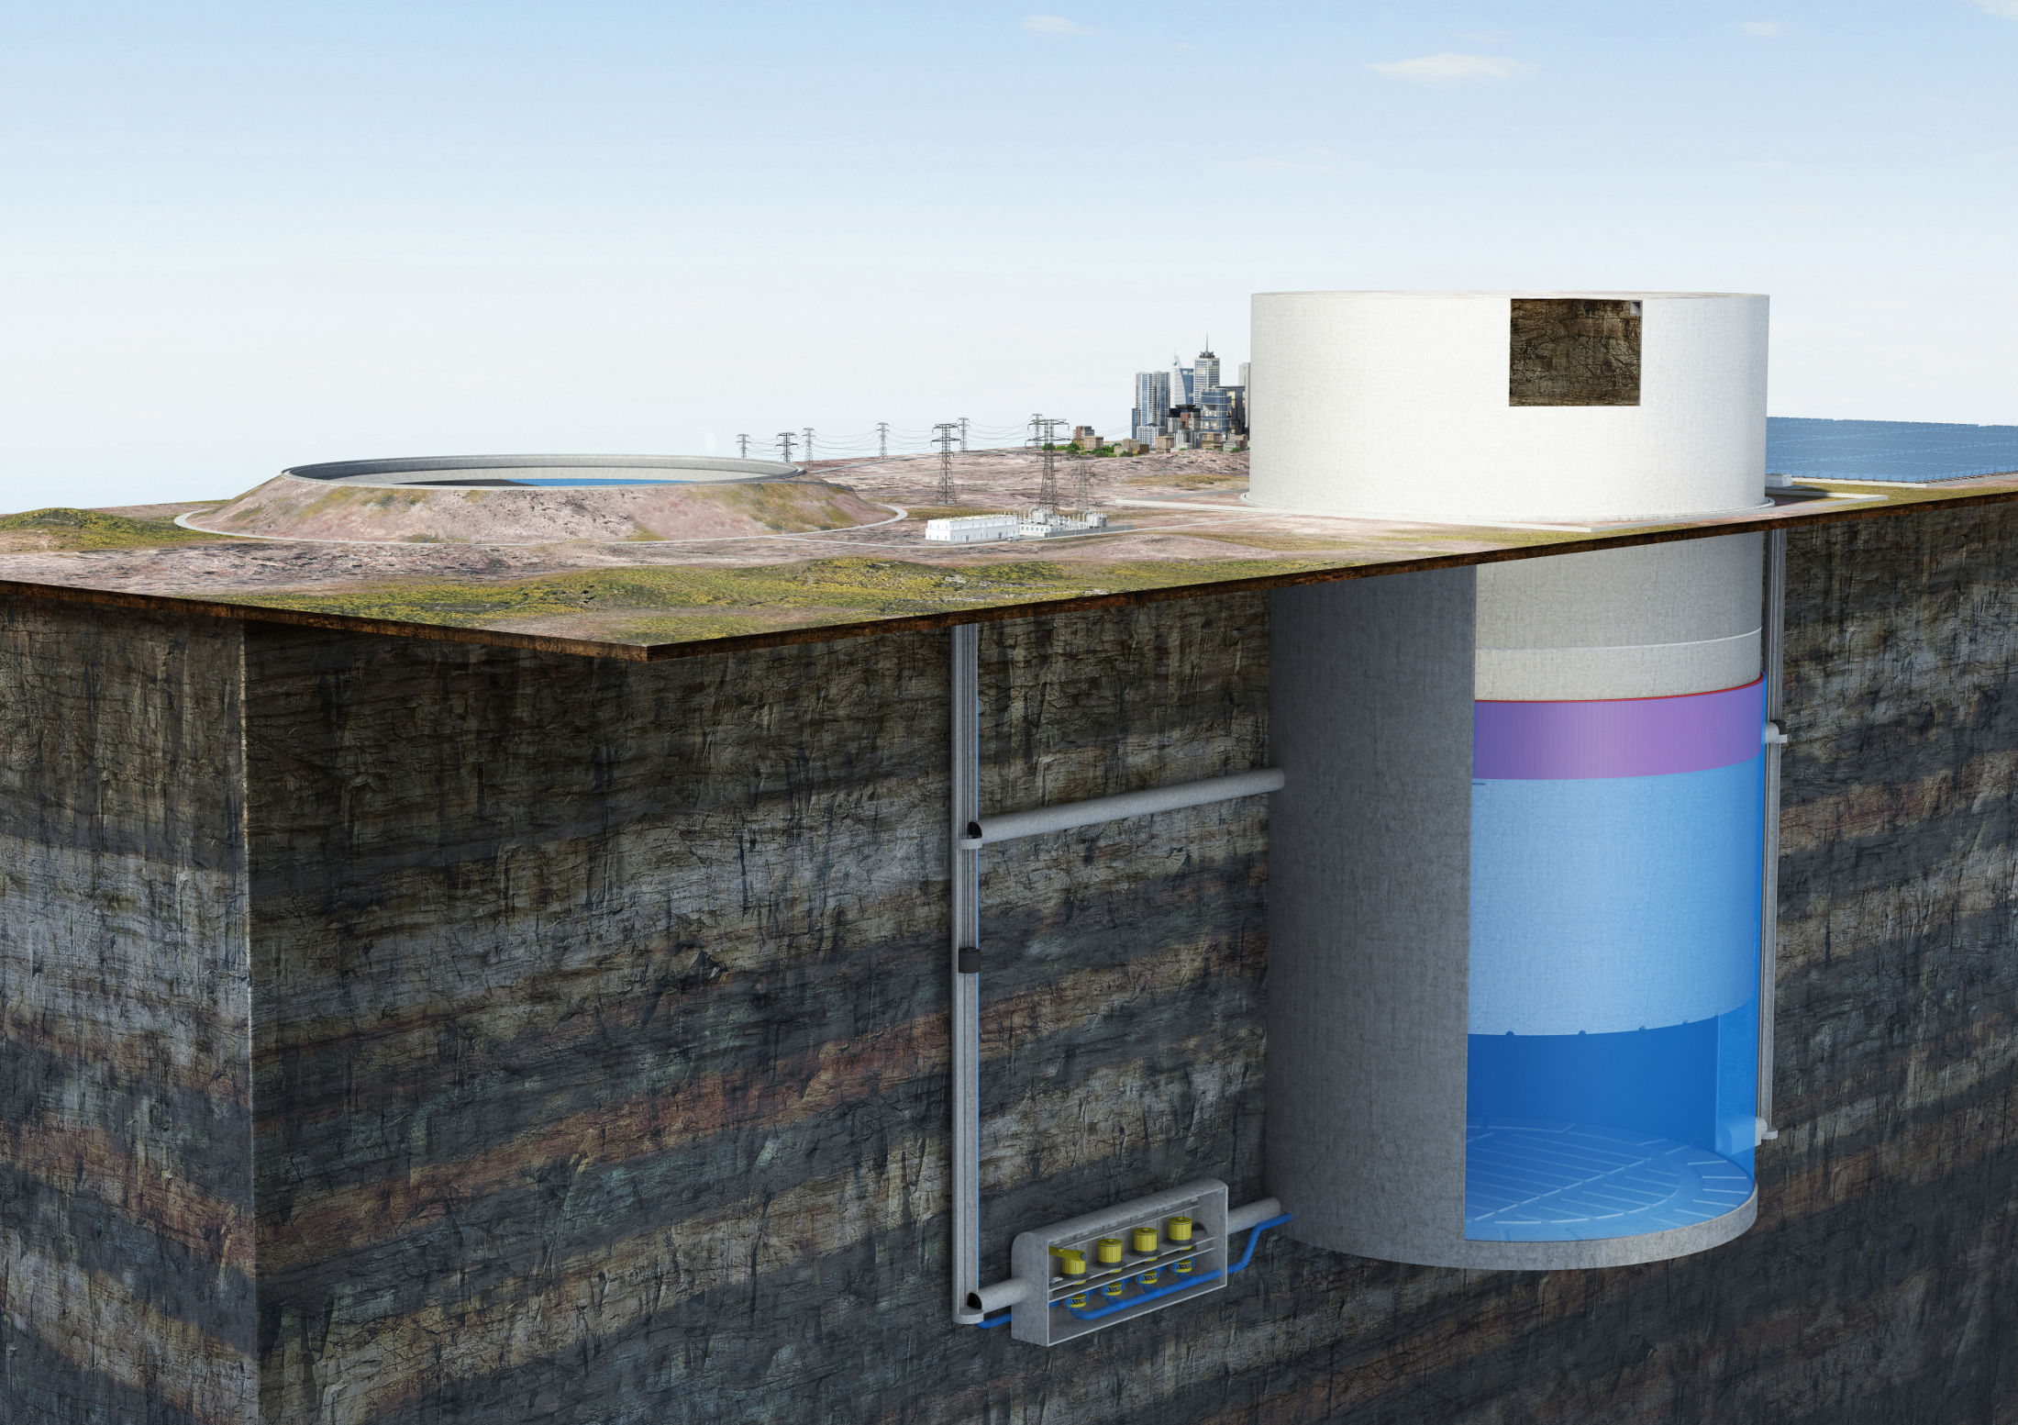
Heindl Storage System
Lifts a large piston mostly made out of Earth to store gravitational potential energy
The lifting mechanism is a set of pumps that forces water underneath the piston causing it to rise
Releases energy by allowing the piston to force the water underneath the mass through a pipe which contains turbines

Slide 5
Storage Variability
Storage variability refers to the speed at which a storage device can adjust from one wattage output to another
The Heindl storage system can readily fluctuate wattage outputs as long as the difference in output is not too large
EX: Release 7 megawatts one second and 8 megawatts the next
This is ideal for supplementing base load energy consumption
Flywheel storage can release and store energy at any pace necessary for grid balancing
EX: Release 5 megawatts, then 20.5 megawatts, then 2 megawatts, etc.
This is ideal for supplementing peak load energy consumption

Slide 6
Our Goal
We want to see how viable it is to have an electrical energy system that only uses clean, renewable energy sources while addressing potential mismatches between energy production and energy consumption with mechanically stored energy
To explore the viability, we are using a software simulation!

Slide 7
Repackaging the Problem
The electrical energy system works in complex, continent-wide grids, and we do not have the level of expertise or academic time to explore this topic on such a scale (at least right now)
We chose to scale the problem to the level of a single city
Our electrical energy demand is just that of Des Moines
Our clean renewables only need to provide for Des Moines
Our storage system only needs to supplement mismatches between energy production and consumption on that corresponding scale

Slide 8
Simulating Real-Time Energy Consumption
Getting consumption data for just the Greater Des Moines Area proves to be quite difficult
How we do it:
Find the energy grid Des Moines falls under (MISO)
Collect the real-time consumption data for that energy grid from the Energy Information Administration
Take a fraction of that data and call that Des Moines’s energy consumption
We are aware that this has inaccuracies, but it is the best method we have thus far
Notes:
https://www.eia.gov/realtime_grid/#/data/table?end=20180306T00&start=20180227T00&bas=00000000000g&timeZone=Central

Slide 9
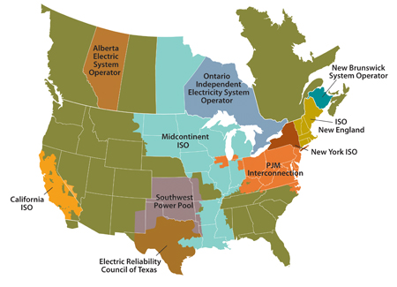
Mid-Continent Independent System Operator

Slide 10
Consumption Curve

Slide 11
Simulating Real-Time Energy Production
We have implemented wind and photovoltaic solar power thus far
Both have different production values based on the month the simulation is ran for
Weather changes are simulated by deviating production values with a random percentage between –X and X
The bigger X is, the more variable the energy source will be in simulation

Slide 12
Wind Power
Wind turbine manufacturers list a max capacity for their turbines EX: 3MW
The max capacity tells us how many joules a turbine can produce a second
A capacity factor is the percent of the max capacity that is produced over a given time frame EX: 25%
We map the capacity factors throughout the day so that the average daily capacity factor is between 25% and 40%

Slide 13
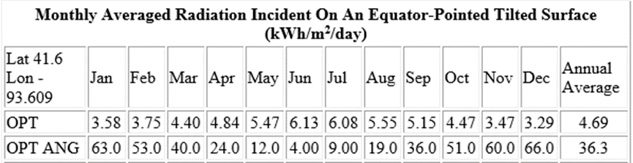
Photovoltaic Solar Power
Use NASA’s Atmospheric Science Data Center to get values for solar radiation hitting around the Des Moines area by month
Assume all solar panels are equator facing and angled optimally

Slide 14
View/User Interface
What is your electricity demand at X time of day?
Wind Farms
How much energy is produced at X time of day?
Energy Sources
Controller
City
Sum all the energy produced at X time of day
Energy produced at X time of day
Keeps track of time of day
Electricity demand at X time of day
Solar Farms
Fulfil the entire energy demand
Energy Commander
Mass-Energy Storage System
Store the extra energy produced
If energy produced > energy demanded
Ask for stored energy to supplement demand
Give all the energy produced to fulfill a portion of the city’s energy demand
+
Give supplemental energy from storage so that the entire city demand is fulfilled
If energy produced < energy demanded
Provide supplemental energy
Heindl Batteries
Flywheels

Slide 15
Software Demonstration

Slide 16
Future Improvements
More clean, renewable energy sources
The more diverse energy sources the better, both in reliability and ecologically
Implement weather simulation models
Reduce technical simplifications in storage systems
Build more cities
Add economic model

Slide 17
Questions and Comments?

